Slide 1
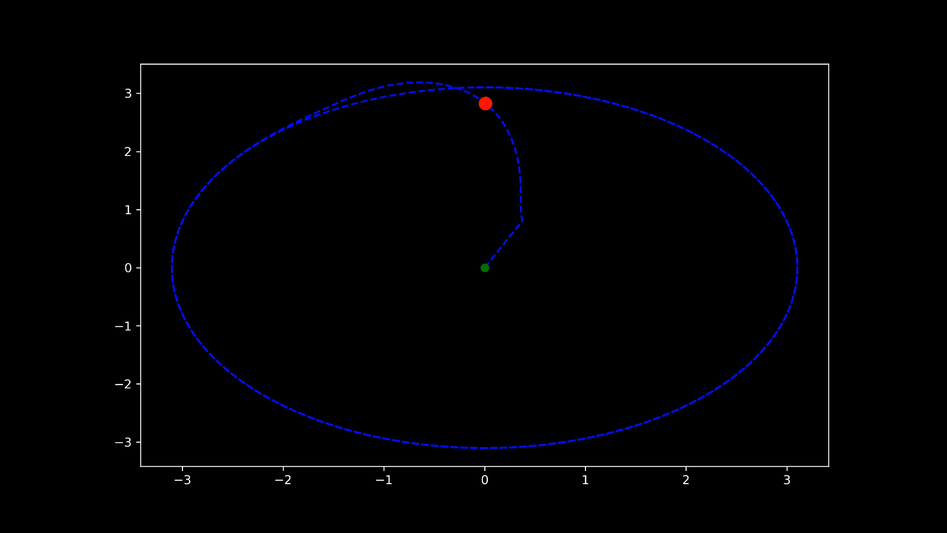
Vector Field Trajectory Tracking Control
Spring 2021 CSE 498 – Adv. Aerial Robotics
Final Presentation
Ruth Densamo

Slide 2
Why Use Vector Fields for Trajectory Tracking ?
Many Control and planning techniques give an output in the form of a vector field along which the robot is intended to follow to accomplish the desired task
Examples : Navigation, Obstacle Avoidance, Collision Avoidance, Swarming and Flocking, Mobile Network connective maintenance controls
Ideal for robots in which dynamics do not play a major role because it is a challenge to control a robot along an arbitrary vector field especially if they have high dimensional nonlinear dynamics
Examples : Ground robots w/ gear reduction, slow moving aerial robots

Slide 3
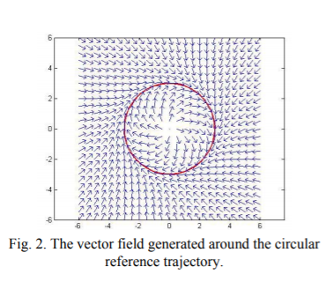
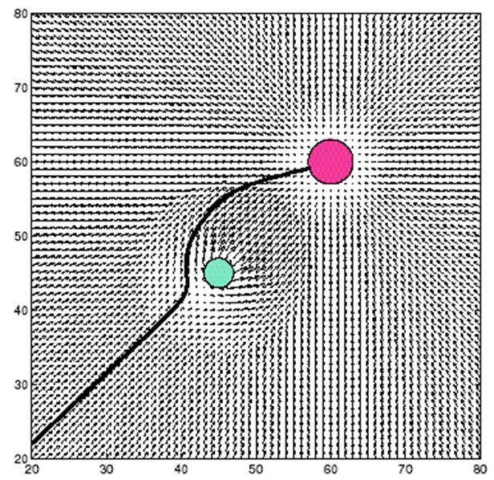
Vector Fields vs. Potential Fields
Vector Fields are like Potential Fields however, Vector Field (right) simply indicates a desired direction and different from potential fiend because it does not represent the gradient of a potential field
Vector fields are general enough for any trajectory
The potential field P(x) is defined over the environment.
Sensor information y is used to estimate the potential field gradient ÑP(x)
The motor vector u is determined to follow that gradient.
Notes:
Kim et al for top image

Slide 4
Limit Cycle

Slide 5
VF Function for Limit Cycle

Slide 6
RK4

Slide 7
SE(3) Controller

Slide 8
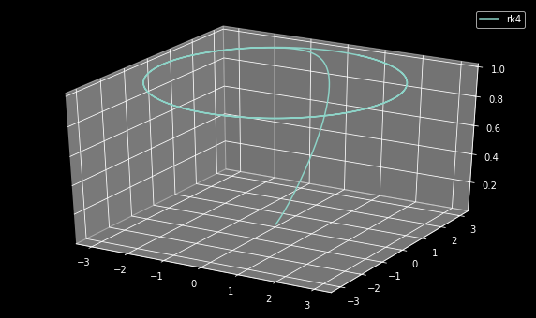
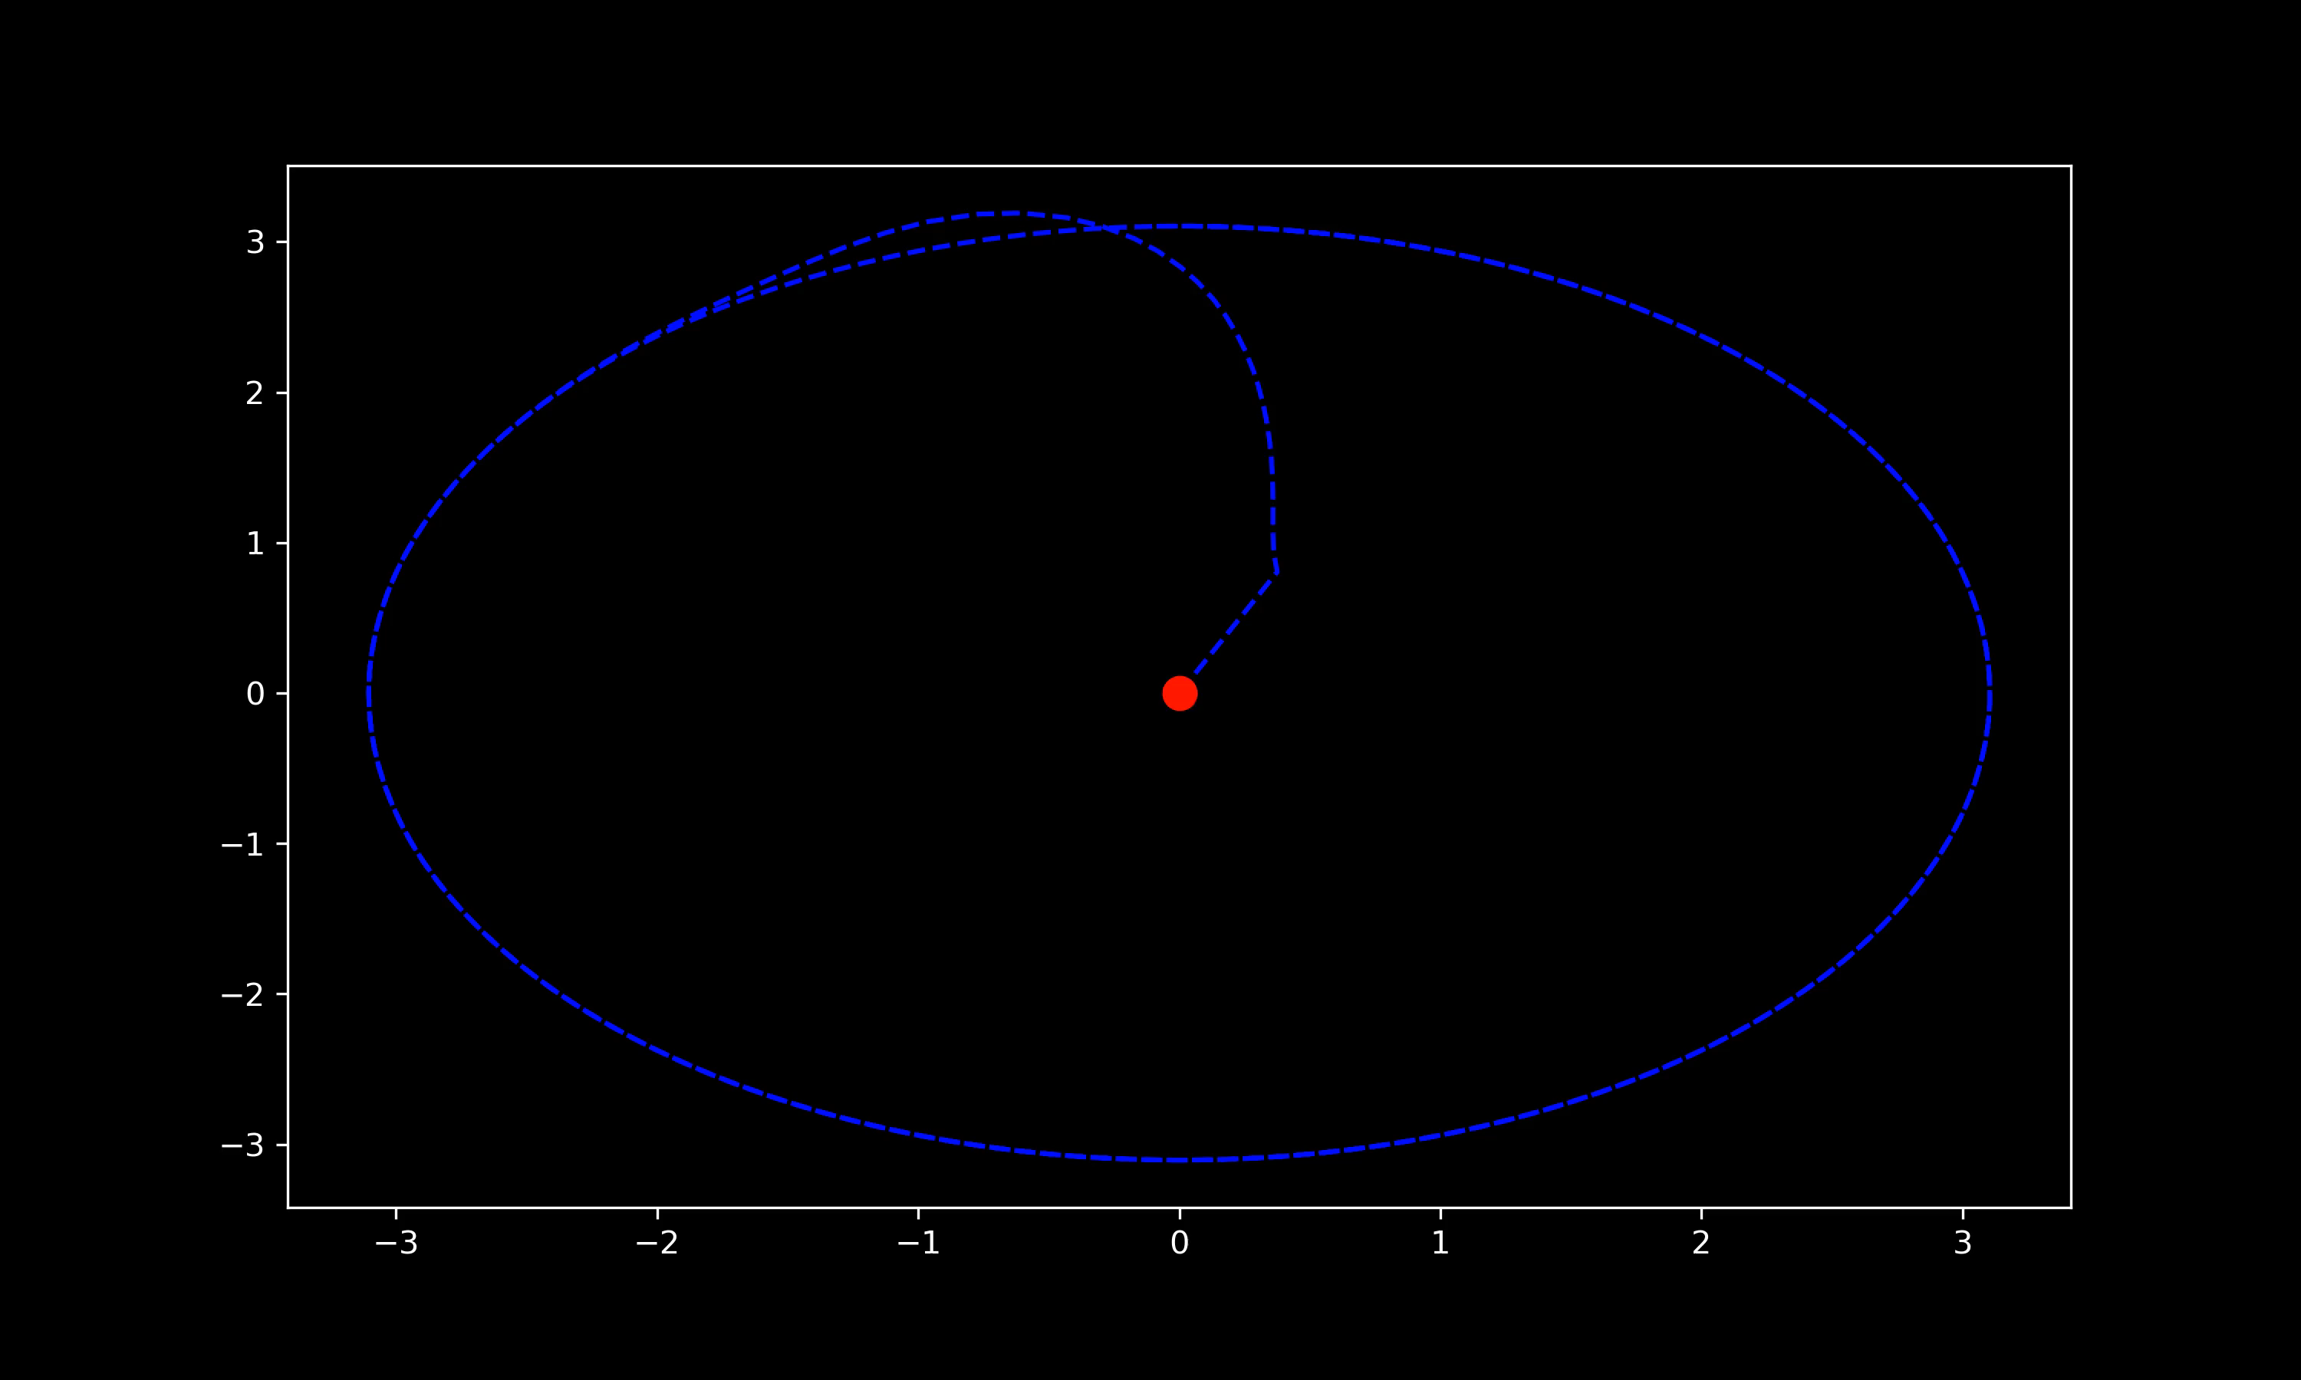
Simulation

Slide 9
Differential Flatness Based Methods

Slide 10
References
Papers:
Github: https://github.com/rdensamo/CSE498-FinalProject-21-Densamo

Slide 11
Hi all,
As we discussed in our last meeting, the final project is going to be this wednesday at 3pm. We will have an external guest, Prof. Rafael Fierro is going to help us to review the projects and provide some feedback.
Each project will have a time slot (15min max) for presentation with the simulation prototype.
Looking forward to it!

Slide 12
Thoughts
Technically isn’t differential flatness treating something like a point? Should explain what differential flatness is
What a limit cycle is
Cite papers

